Slide 1
DETECTION OF FRAUDULENT WEBSITES USING MACHINE LEARNING
20RH1A6604-A.Vaishnavi
20RH1A6625-G.Sahruthi
20RH1A6651-P.Varshini
20RH1A6601-A.Nikshitha

Slide 2
ABSTRACT
Phishing is an internet scam in which an attacker sends out fake messages that look to come from a trusted source. A URL or file will be included in the mail, which when clicked will steal personal information or infect a computer with a virus. Traditionally, phishing attempts were carried out through wide-scale spam campaigns that targeted broad groups of people indiscriminately. The goal was to get as many people to click on a link or open an infected file as possible. There are various approaches to detect this type of attack. One of the approaches is machine learning. The URL’s received by the user will be given input to the machine learning model then the algorithm will process the input and display the output whether it is phishing or legitimate. There are various ML algorithms like SVM, Neural Networks, Random Forest, Decision Tree, XG boost etc. that can be used to classify these URLs. The proposed approach deals with the Random Forest, Decision Tree classifiers. The proposed approach effectively classified the Phishing and Legitimate URLs with an accuracy of 87.0% and 82.4% for Random Forest and decision tree classifiers respectively.
Keywords:Decision Tree, Phishing, Legitimate,SVM, XG Boost.

Slide 3
INTRODUCTION
Phishing can be defined as impersonating a valid site to trick users by stealing their personal data comprising usernames, passwords, accounts numbers, national insurance numbers, etc. Phishing frauds might be the most widespread cybercrime used today.
The user can be notified if blacklisted website is being accessed. The admin can capture the blacklisted URL’s to alert user. The system involves features like capturing blacklisted website, viewing blacklisted website, displaying pop-up notification and also displaying email notification

Slide 4
requirements
SOFTWARE REQUIREMENTS:
Operating system : Windows, Ultimate, Linux, Mac.
Front-End : Python, JavaScript, HTML, CSS.
Coding Language : Python.
Software Environment : Jupyter Notebook.
HARDWARE REQUIREMENTS:
System : Intel i Processor.
RAM : 4GB

Slide 5
EXISTING SYSTEM
In the existing system the algorithms used and compared are support vector machine(SVM), decision tree and random forest.
Only few features are considered to detect the phishing websites.
The only metric used is accuracy score.
DISADVANTAGES
Accuracy.
Metrics used.
Features

Slide 6
PROPOSED SYSTEM

Slide 7
LITERATURE REVIEW
S.no | Authors | Contribution | Limitations
1. | Jain A.K., and Gupta B.B (2017) | A combination of the NB and SVM algorithms were used to find the dangerous websites. | SVM and NB are both slow learners and do not keep track of previous outcomes in memory. As a result, the URLdetector's effectiveness can be diminished.
2. | Gandotra E., and Gupta D. (2020) | a variety of categorization algorithms were used to find dangerous URLs. | The results of the studies showed that the system's performance was superior to that of other ML techniques. It cannot handle bigger amounts of data, though.
3. | Aljofey A et al. (2022) | a phishing page detection system based on CNN. To discover URLs, a sequential pattern is employed . | According to the available studies, CNN works better at fetching images than words.
4. | AlEroud A and Karabatis G (2020) | The research uses a generative adversarial network to get around a detection mechanism. | By learning about the environment around it, a neural network-based detection system can recognise the impression of an unfavourable network.
5. | Hung Le et al. (2018) | a deep learning-based URL detector was proposed. According to authors, the approach can generate insights from URL. | Deep learning techniques require more time to complete a task. Additionally, it parses the URL and compares it to the library to produce a result.

Slide 8
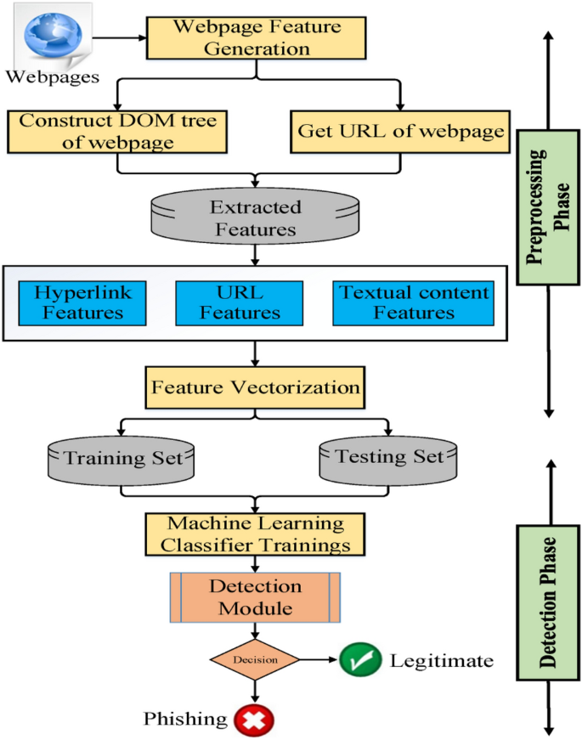
System Architecture

Slide 9




Slide 10

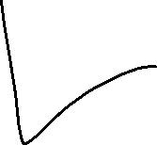


Slide 11
modules
beautifulsoup4==4.9.3
scikit_learn==1.0.1
Flask==2.0.2
Numpy
Pandas
Gunicorn
Dateutil
Requests
whois

Slide 12
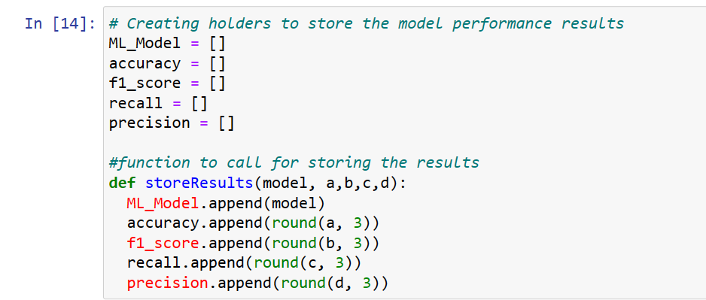
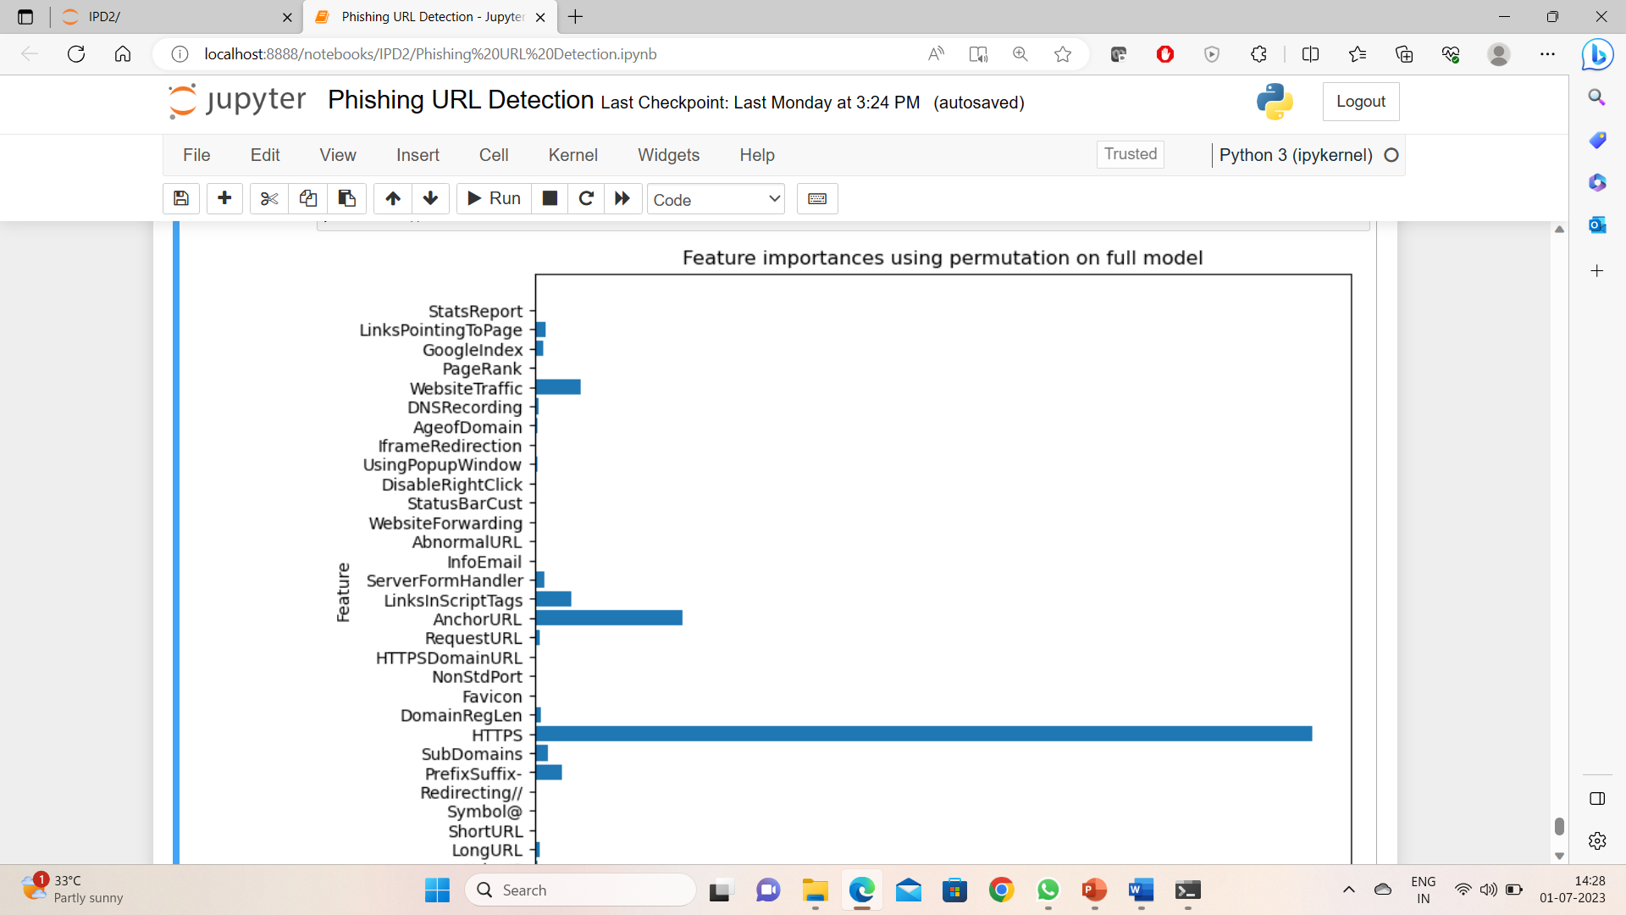
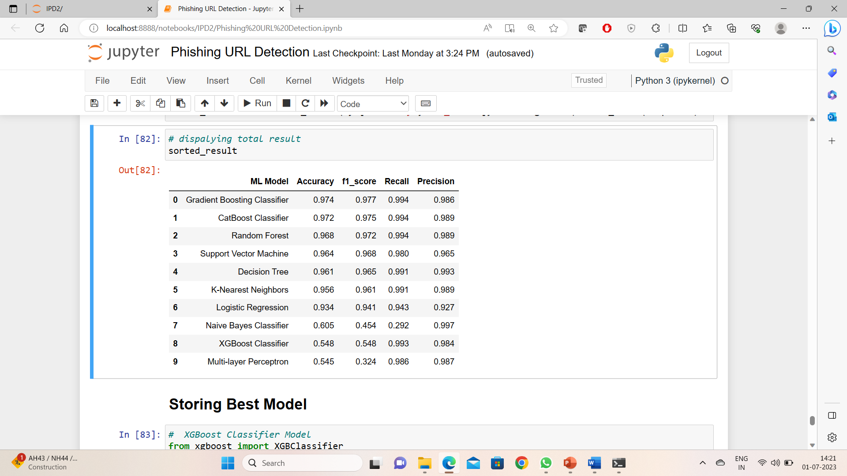
Source code

Slide 13
testing
s.no | Test scenario | Test steps | Test data | Expected result | Success/ Failure
1 | Check with valid phishing websites | Test with phishing dataset | URL 1 | Successful in displaying the result | Success
2 | Check with legitimate websites | Test without phishing dataset | URL 2 | Successful in displaying the result | Success
s.no | Test scenario | Test steps | Test data | Expected result | Success/ Failure
1 | Check with valid phishing websites | Test entering URL to user interface | URL 3 | Successful in displaying the result | Success
2 | Check with legitimate websites | Test entering URL to user interface | URL 4 | Successful in displaying the result | Success

Slide 14
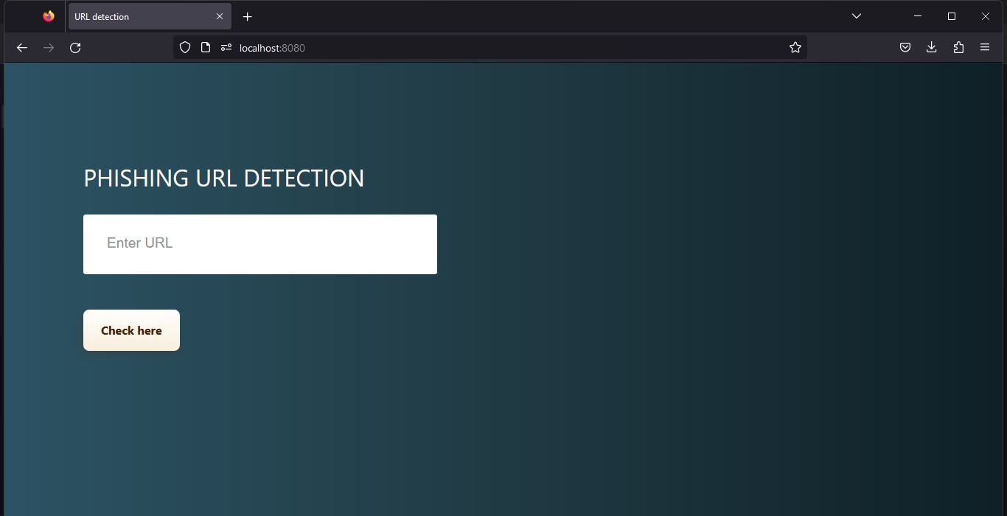
results

Slide 15
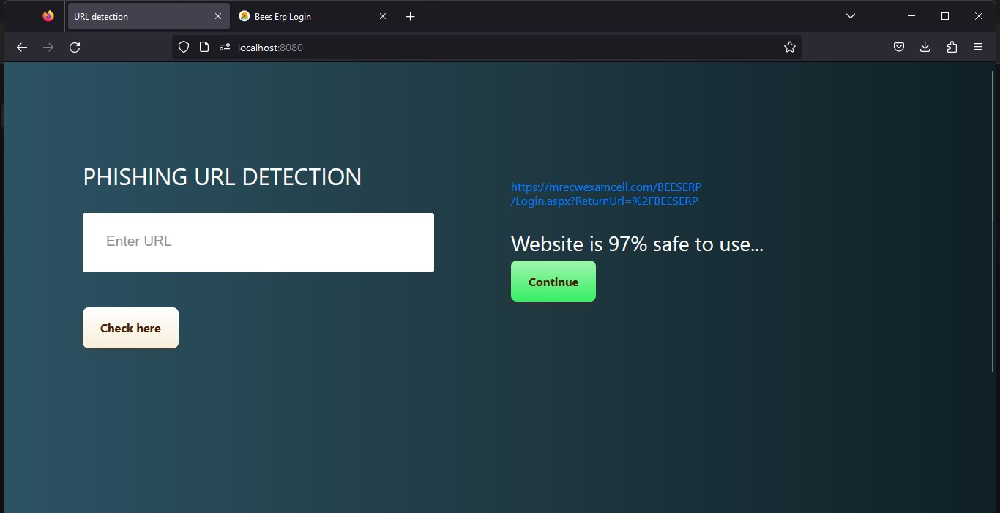
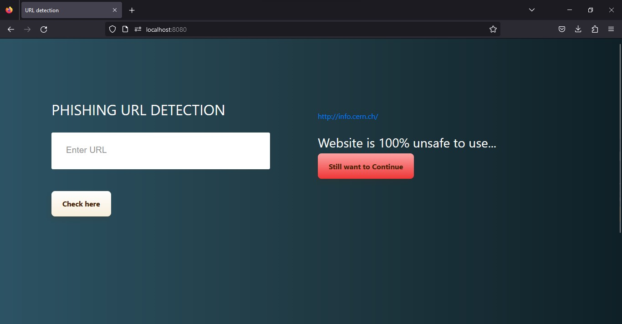

Slide 16
conclusion
In conclusion, this system is designed for resources are used as intended, prevents from valuable information from leaks out, produce better control mechanism and alerts the user to keep their private information safe. Like any other programs, there are improvements which could be made into this system. Based on the capabilities which the current system processes, text message integration would a great recommendation that could be made to improve the program in the future.

Slide 17
FUTURE SCOPE
In future if we get structured dataset of phishing we can perform phishing detection much more faster than any other technique.In future we can use a combination of any other two or more classifier to get maximum accuracy. We also plan to explore various phishing techniques that uses Lexical features, Network based features,Content based features, Webpage based features and HTML and JavaScript features of web pages which can improve the performance of the system. In particular, we extract features from URLs and pass it through the various classifiers.

Slide 18
references
1)Gunter Ollmann, “The Phishing Guide Understanding & Preventing Phishing Attacks”, IBMInternet Security Systems, 2007.
2) Mohammad R., Thabtah F. McCluskey L., (2015) Phishing websites dataset. Available: https://archive.ics.uci.edu/ml/datasets/Phishing+Websites Accessed January 2016
3) Mahmoud Khonji, Youssef Iraqi, "Phishing Detection: A Literature Survey IEEE, and Andrew Jones, 2013
4) Rishikesh Mahajan (2018) “Phishing Website Detection using Machine Learning Algorithms”
5)Purvi Pujara, M. B.Chaudhari (2018) “Phishing Website Detection using Machine Learning : A Review”

Slide 19
Thank you.

